Slide 1

Single and dual phase Lock-in amplifier
7th semester Open lab Final presentation
Gaurav Kanu
1811067
National Institute of Science Education and Research

Slide 2
Overview
Introduction
Simulation software
Preamplifier
Single phase lock-in
Dual phase lock-in
Circuits & Observations
Results
Conclusion

Slide 3
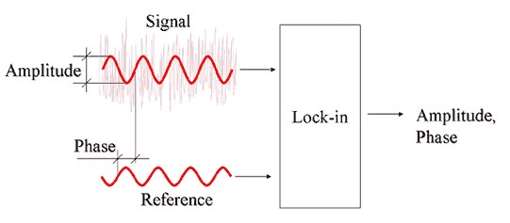
Introduction
Lock-in amplifiers are used in daily basis to filter out the signal of interest from the noisy a signal.
The input signal is mixed with reference
signal.
The higher frequency component is
dropped.
Remaining lower frequency signal is the desired output.

Slide 4
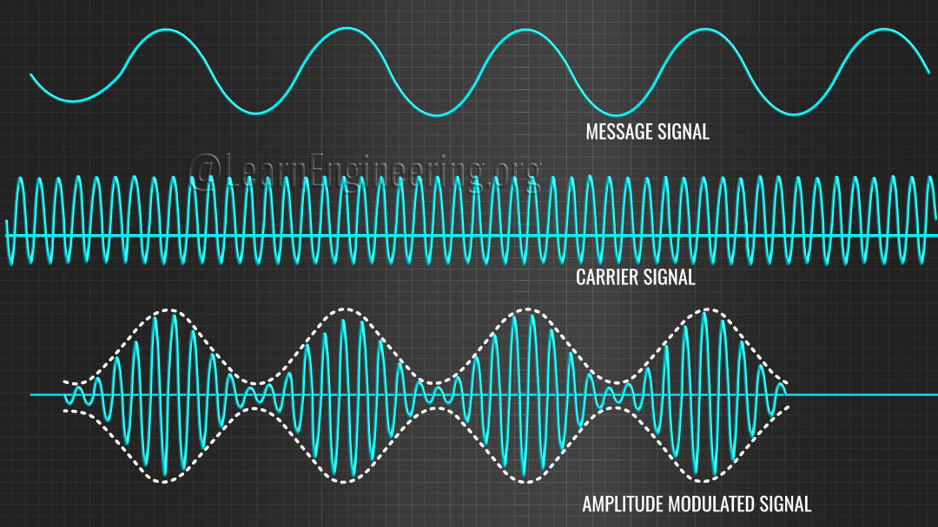
History
Modulation
Amplitude modulation (AM) technique:
Oldest technique for the broadcasting of radio programs.
The amplitude of carrier signal is varied depending upon the value of message signal.
Disadvantages:
Sensitive to noise.
Inefficient in terms of power.

Slide 5
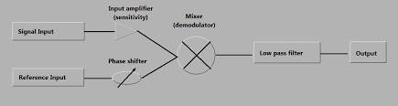

Lock-in amplifier single phase:
$V_{signal}=V_{s}\sin{ω_{s}t+φ_{s}}$ -(1)
$V_{reference}=V_{R}\sin{ω_{R}t }$ -(2)
On mixing the signals:
$$V_{psd}= V_{s}V_{R}\sin{{(ω}_{s}t+ω_{R}t+φ_{s})\sin{{(ω}_{s}t−ω_{R}t+φ_{s})}}$$
$V_{psd}= \frac{V_{s}V_{R}}{2}[cos\left(ω_{s}t+ω_{R}t+φ_{s}\right)−\cos{(ω_{s}−ω_{R}t+φ_{s})]}$ -(3)
Low pass filter removes the 2nd term from (3)
After low pass:
$$V_{out}=\frac{V_{s}V_{R}}{2}\cos{{(ω}_{s}t −ω_{R}t+φ_{s})}$$
1

Slide 6
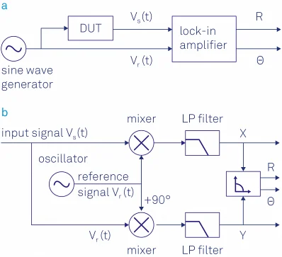

Dual phase lock-in
LIA X:
$X= \frac{1}{2}V_{s}V_{R}\cos{{(φ}_{s})}$ (when, $ω_{s}=ω_{R}$)
LIA Y:
Y$= \frac{1}{2}V_{s}V_{R}\sin{{(φ}_{s})}$
$$R=\sqrt{X^{2}+Y^{2}}=μV_{s}$$
$$φ_{s}=\tan^{−1}{(Y/X)}$$

Slide 7
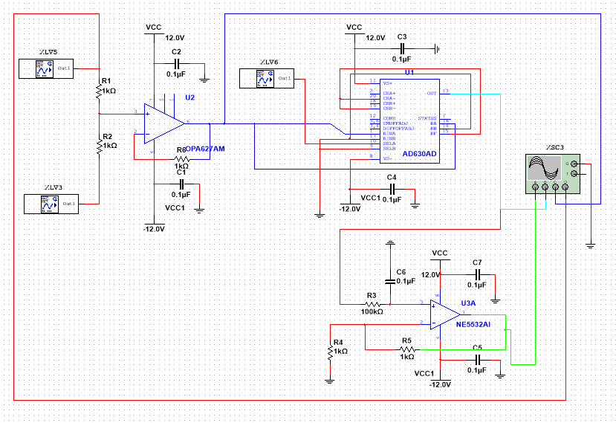
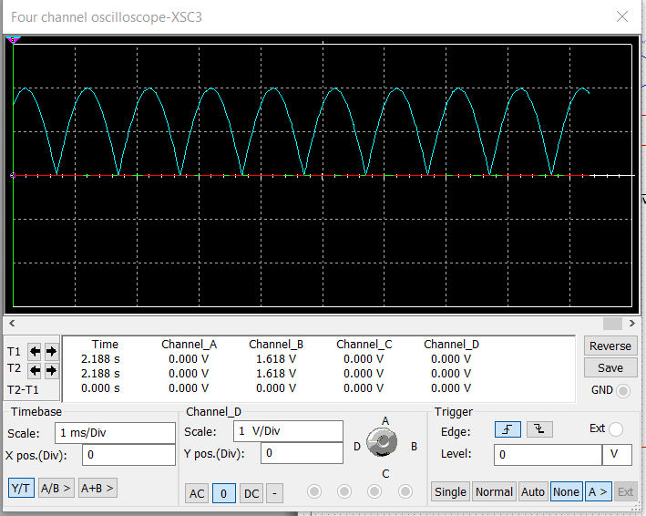
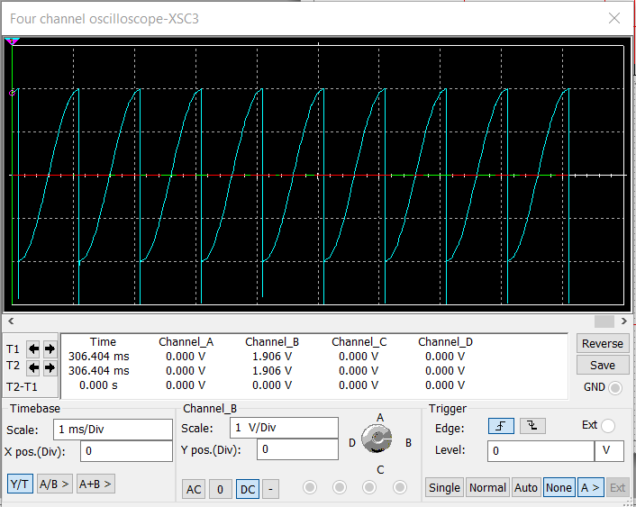
Single phase lock-in amplifier circuit
Phase = 0°
Phase =90°

Slide 8
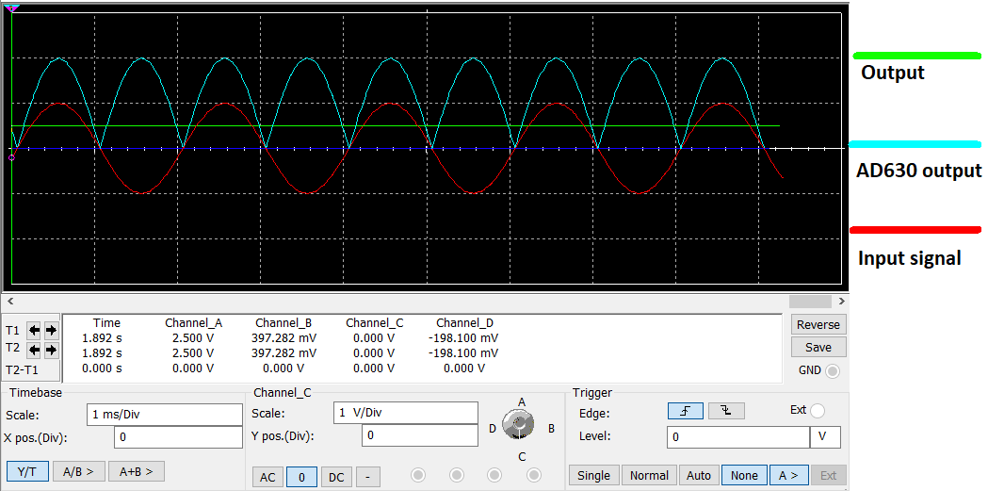
Single phase lock-in amplifier output
Input f = 500 Hz

Slide 9
Amplification factor (µ)
Amplification factor = 2.532

Slide 10
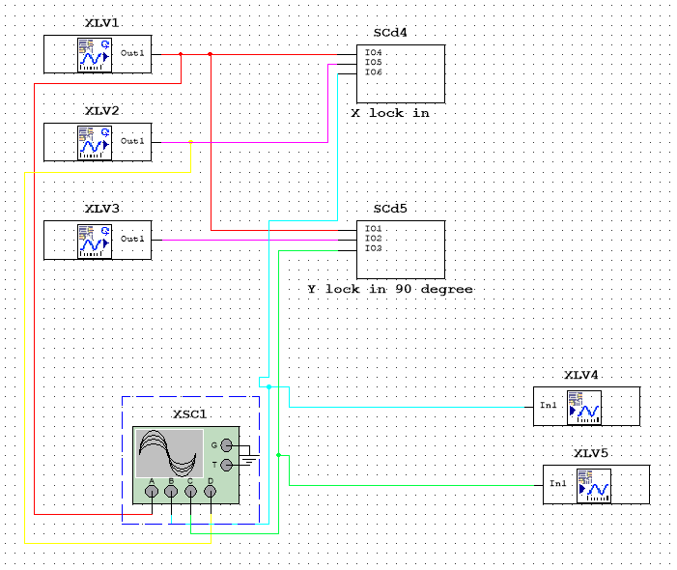
Dual phase lock-in amplifier circuit

Slide 11
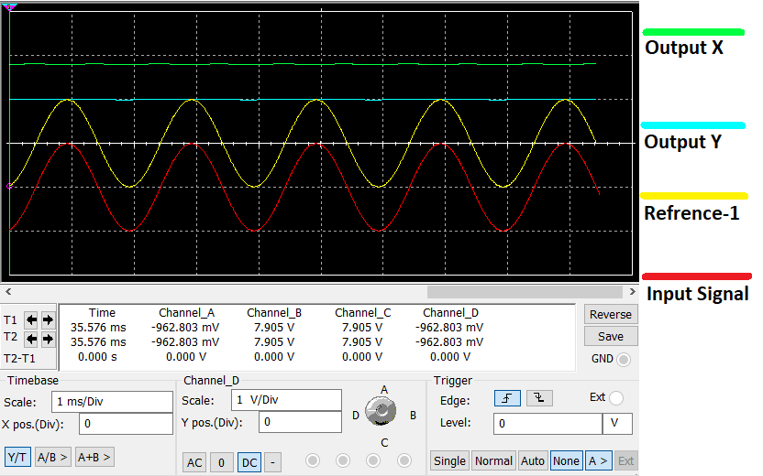
Dual phase lock-in output:

Slide 12
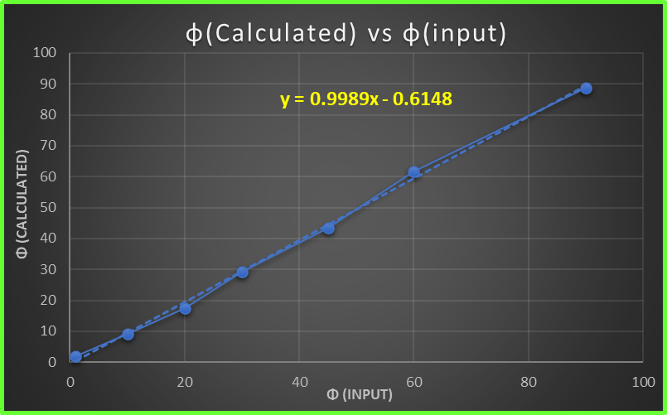
Phase calculation

Slide 13
Amplification factor of dual phase (µ)
‘R’ is the net magnitude from both the lock-in amplifiers.
Amplification factor = 2.5286

Slide 14
Incorporating noise in the simulation
•Input signal(blue) f=500Hz, 1V
•Noise(cyan)
•Input signal and noise(Red)
•LIA output(green) V-DC=1.21V

Slide 15
Conclusion
Single phase and Dual phase lock-in are simulated using Multisim with outputs similar to theoretical results.
Amplification factor of the lock-in amplifier is found to be 2.532
For Dual phase lock-in amplifier, phase is verified and amplitude of the output is plotted with V-input.
Our lock-in amplifier circuit can successfully amplify and extract weak signals.
In the presence of noise also the lock in amplifier successfully separated the weak message signal.

Slide 16
References
Wei, Cao, Liang Jie, and Li Hui. "Simulation and experimental design of the locking amplifier based on Multisim." 2015 Fifth International Conference on Instrumentation and Measurement, Computer, Communication and Control (IMCCC). IEEE, 2015
Humayun, Fardin, et al. "Design of a cost-effective analog lock-in amplifier using phase sensitive detector." 2018 International Applied Computational Electromagnetics Society Symposium (ACES). IEEE, 2018.
NISER, SPS-Lab manuals
AD630 manual modulator/demodulator

Slide 17


